Slide 1
A team Project 6X6 Tic Tac Toe Game
By Ibra, Eddie, Jason, Carrie, Alexis, Alfonso

Slide 2
Use Cases

Slide 3
Non Functional Requirements

Slide 4
Scenarios

Slide 5
Class Diagram

Slide 6
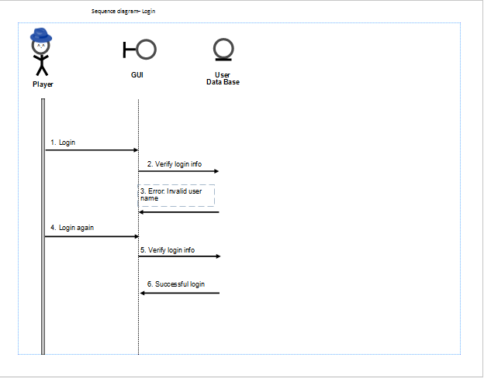
Sequence Diagrams
Login

Slide 7
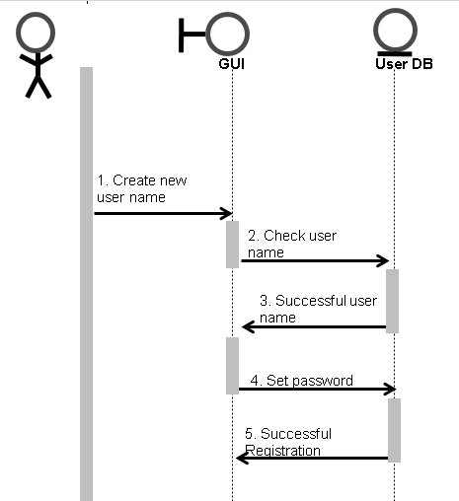
Sequence Diagrams cont.
New User

Slide 8
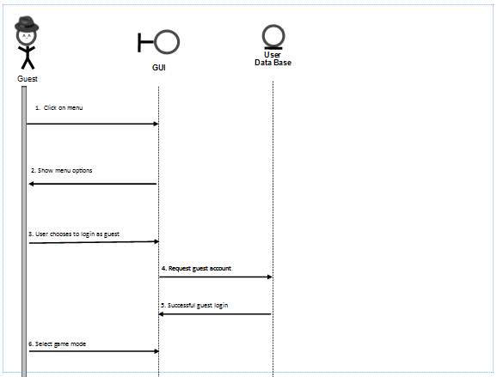
Sequence Diagram cont.
Player logs in as guest

Slide 9
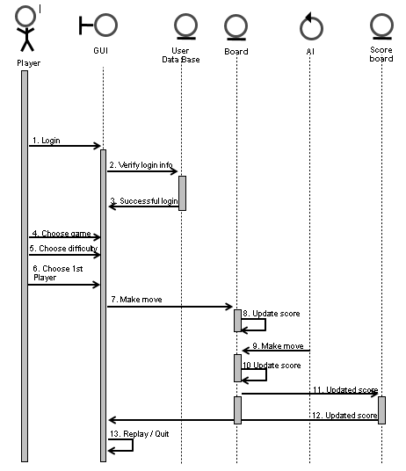
Sequence Diagrams cont.
Registered player vs AI

Slide 10
Project Management Plan

Slide 11
Detail Design

Slide 12
Test Plan

